Slide 1
Life Without Parole:
An American Human
Rights Crisis
Notes:
Here is where we each give a brief introduction of ourselves, our work history, and how we got involved in ending LWOP.

Slide 2
The History of Life Without Parole (LWOP)
in the United States
Notes:
Let us now start with a brief overview of the history of LWOP in the United States.

Slide 3
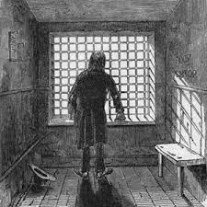
In 1851, President Millard
Fillmore commuted the
sentence of convicted
murderer William Wells
from death by hanging
to LWOP.
This was the first time
the punishment of
LWOP was used in
the United States.
Notes:
The first time someone was sentenced to LWOP was in 1851. On the day of Wells’ execution, President Fillmore commuted his sentence from death by hanging to LWOP.

Slide 4
Wells appealed his LWOP sentence, arguing
that the president did not have the authority
to impose a new condition when granting
a reprieve from execution.
In Ex Parte Wells, the U.S.
Supreme Court disagreed, endorsing LWOP
for the first time.
Notes:
Wells appealed, arguing that the President lacked the authority to impose a new condition (LWOP). However, is Ex Parte Wells, the US Supreme Court upheld Wells’ sentence, thereby endorsing LWOP for the very first time.

Slide 5
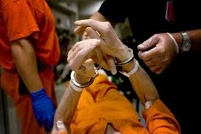
“An act has been done, entirely inconsistent with reprieve, as that only suspends the punishment for a fixed period…It is a perversion of the facts to say that Wells has been
reprieved by the President.”
--Justice McLean in Ex Parte Wells
Notes:
It is interesting to note that Justice McLean was aware that LWOP is in actuality a death penalty of a different type.

Slide 6
After Wells, LWOP remained a
rarity for over a hundred years.
Then, in 1972, the U.S. Supreme Court
ended the traditional death penalty
in Furman v. Georgia, bringing about
unintended consequences.
Notes:
In Furman, the Court held the traditional death penalty was unconstitutional because of the “arbitrary and capricious” manner in which it was applied. The states knew, however, if this issue could be corrected , the Court would once again uphold the constitutionality of execution. (as it did in 1976 in Gregg v Georgia). Nevertheless, in the intervening time, many states scrambled to pass laws to prevent prisoners previously sentenced to death from being released. This was the beginning of the massive rise of LWOP sentencing in our country.

Slide 7
Source: No Exit: The Expanding Use of Life Sentences in America, The Sentencing Project, July 2009
Notes:
Between 1972 and 1992, the number of LWOP sentences rose from essentially none to over 12,000. By 2003, the number rose to over 33,000, and by 2008, it was over 41,000.

Slide 8
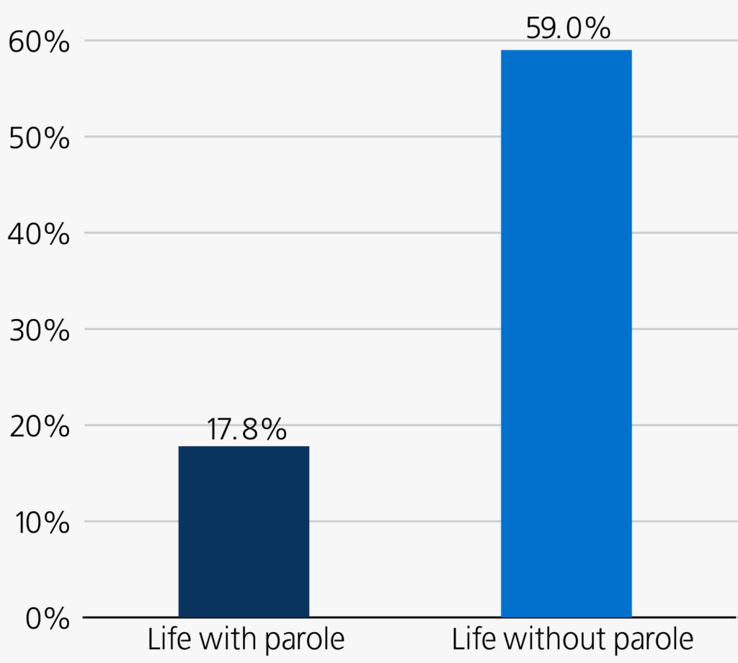
Between 2003 and 2016,
LWOP sentences
increased by 59%. In 2016,
53,290 people were
serving LWOP in the
United States.
o
Source: Still Life: America’s Increasing Use of Life and Long Term Sentences, The Sentencing Project, May 3, 2017
Notes:
Latest statistics from the Sentencing Project show that currently over 53,000 people are serving LWOP in the US. The increase in LWOP sentences between 2003 and 2016 (59%) vastly eclipses the increase in the number of life with parole sentences (17%) during the same time period.

Slide 9
Racial Disparities in LWOP Sentencing
Notes:
Now let us turn to the enormous racial disparities in LWOP sentencing.

Slide 10
At every stage, the criminal justice system is defined
by stark racial disparities. These are most pronounced
among people serving LWOP and “de facto” LWOP.
Notes:
While there are enormous racial disparities throughout the criminal justice system, it is most prominent in LWOP sentencing. (“De facto” LWOP are sentences that exceed the human lifespan if carried out in full—e.g., 120 years . Recent statistics from the Sentencing Project show that over 44,000 people are serving de facto LWOP in the United States.)

Slide 11
In nine states,
African-Americans
make up 2/3 or more
of the
LWOP-sentenced
prisoner
population.
These are: Alabama, Georgia, Illinois,
Louisiana, Maryland, Michigan,
Mississippi, New Jersey, and South
Carolina.
Source: Still Life,
The Sentencing Project, 2017
Notes:
In the states listed (read names of states), African-Americans make up 2/3 or more of people serving LWOP.

Slide 12
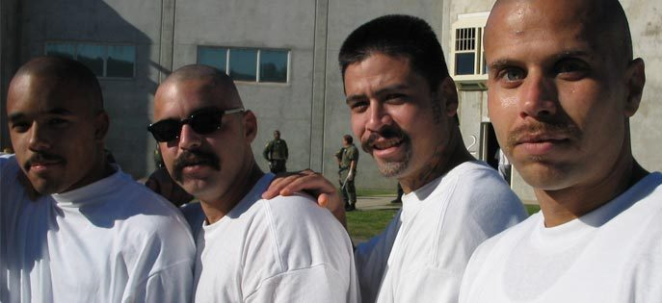
Among people serving “de facto” LWOP sentences, people
of color comprise over 65 percent. African-Americans make up
more than half, and Latinos nearly 12 percent.
Source: Still Life, The Sentencing Project, 2017
Notes:
Also according to the Sentencing Project, people of color comprise over 65% of those sentenced to “de facto” LWOP.

Slide 13
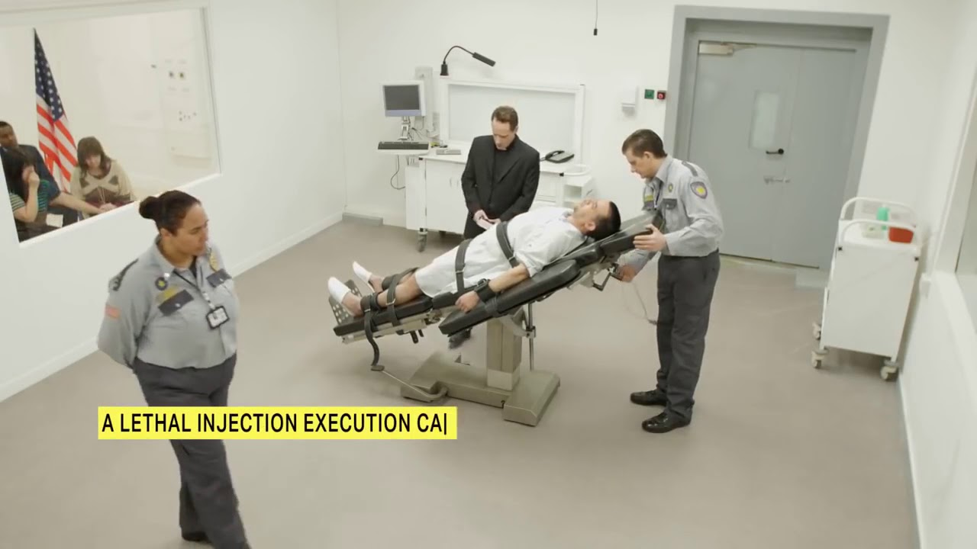
LWOP and the Abolition
of the Traditional Death Penalty
Notes:
There is a complicated connection between LWOP and the ending of the traditional death penalty (usually lethal injection).

Slide 14
Many activists opposing direct
execution (e.g., lethal injection)
promote LWOP as a “reasonable
alternative,” believing the only
way the public would support
their cause is if LWOP is firmly
entrenched in the law.
Notes:
Well meaning traditional death penalty abolitionists take the position that LWOP is necessary to achieve their goals of ending lethal injection, believing they will be unable to gain sufficient public support without an option that ensures certain people will never leave prison.

Slide 15
Returning to end LWOP after the traditional death penalty is abolished?
Notes:
In 2009, while serving as the free world liaison for the Other Death Penalty Project, I met Mike Farrell at a conference. He acknowledged that LWOP is also the death penalty, but said we must keep it until lethal injection is permanently ended and then we can go back to end LWOP. (Mike was the author of the 2016 “Justice That Works” California voter initiative to end lethal injection and replace it with an even more harsh and punitive version of LWOP.) Unfortunately, this strategy will not work as once LWOP is cast as a just sentence, it is impossible to go back to the public and say, “Sorry—I made a mistake! LWOP is wrong and let’s end it too!”

Slide 16
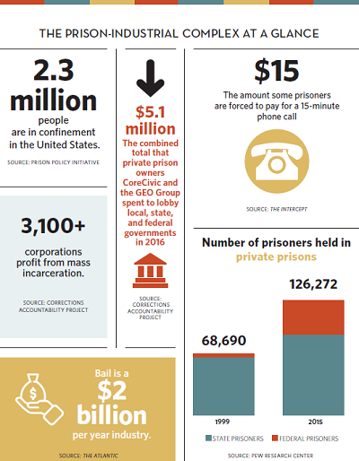
The Prison-Industrial Complex and the Expansion of LWOP
Notes:
There are many corporations which benefit from keeping the number of prisoners as high as possible, and people with LWOP fit that bill nicely as they never go home.

Slide 17
Notes:
Two of the largest private prison companies, Core Civic (used to be called Corrections Corporations of America (CCA)) and the Geo Group, make tremendous profits for their shareholders on the backs of incarcerated people.

Slide 18
Over the past fourteen years, the Geo Group gave $6,819,204 in
campaign donations. In 2014, Geo contributed $54,000 to gubernatorial
candidates Edmund G. Brown, Jr. of California, and $50,000
to Greg Abbott of Texas, the states with the largest prison
populations.
Over the past nineteen years, CoreCivic contributed $5,438,958 to
political candidates, including $37,200 to Governor Brown in 2014 and $20,000
to Texas Governor Rick Perry in 2006.
The Geo Group hired 326 lobbyists during this time period, and
Core Civic hired 462.
Source: followthemoney.org
Notes:
Discuss campaign donations and lobbyists as noted on slide.

Slide 19
The prison guards’ union has
contributed an astonishing
$35,611,053 over the past nineteen years
to political candidates in California alone
who promised to put more
people in prison.
Source: followthemoney.org
Notes:
The California prison guards’ union used to be a formidable force in keeping the number of prisoners as high as possible to benefit their members. Their power has decreased markedly in recent years with changes in California’s criminal justice policies.

Slide 20
Childhood Trauma
and LWOP:
A Perspective From
the Adverse
Childhood Experiences
(ACE) Study
Notes:
I will do the childhood trauma section so no need for notes on the next few slides.

Slide 21
Adverse Childhood Experiences (ACE) Study
Conducted by the CDC and Kaiser Permanente
Published in 1998 in the American Journal of Public Health
Nearly 20,000 participants
Found a powerful relationship between emotional experiences as children and adult health and the leading causes of mortality
Notes:
N/A

Slide 22
What Are Adverse Childhood Experiences (ACEs)? Growing up in a household with:
Recurrent emotional, physical, or sexual abuse
Recurrent emotional or physical neglect
An alcoholic or drug abuser
An incarcerated family member
A mentally ill family member
Situations in which the mother is treated violently
One or no parents
Note that more subtle forms of trauma, such as
attachment trauma, are not included in this list.
Notes:
N/A

Slide 23
Trauma Defined:
* The unique individual
experience of an event or
ongoing conditions in
which the person’s
ability to cope
is overwhelmed.
* Disruption of a relationship
without repair.
Notes:
N/A

Slide 24
ACE Study Findings
More than half of the (middle-class) Kaiser participants had at least one ACE factor
One-quarter had two factors
One-sixteenth had four or more
Adverse childhood experiences are far more common than is recognized
They have a powerful correlation to adult health even half a century later
Notes:
N/A

Slide 25
Significance of ACE Study Findings
Leading Causes of Death
The Higher the ACE Score, the Higher the Risk for:
Smoking
Severe obesity
Physical inactivity
Depression
Suicide attempt
Alcoholism
Illicit/IV drugs
>50 sexual partners
STDs
Heart disease
Cancer
Stroke
COPD
Suicide (8th for men)
Diabetes
HIV/AIDS/HCV
Notes:
N/A

Slide 26
Life and death in prison: One of the clearest examples
of the impact of childhood trauma on society.
Notes:
N/A

Slide 27
Adverse Childhood Experiences (ACE) and Adult Criminality Study
Conducted by the Correctional Service of Canada—Psychology, Ontario, and Intrapsychic in San Diego
Published in 2013 in the Kaiser Permanente Journal
Small study (151 participants) but first of its kind
Concluded that childhood adversity is strongly associated with adult criminality, and called for additional studies to be done.
Notes:
N/A

Slide 28
“…the best starting hypothesis in dealing with most killers is that they
are ‘untreated traumatized children inhabiting and controlling the dangerous
adolescents and adults that stand accused of murder.’”
--James Garbarino, Ph.D.
The Center for the Human Rights of Children
Loyola University, Chicago
From “ACES in the Criminal Justice System,” Academic Pediatrics, 2017: 17 S32-S33
Notes:
N/A

Slide 29
Why Should We End LWOP?
It is a death sentence—death
by incarceration—which is imposed with
enormous racial disparities.
Its total deprivation of hope,
regardless of degree of rehabilitation,
is cruel and inhumane—the antithesis
of restorative justice.
Ending LWOP does not mean all prisoners
will be released, only that they will have the
chance to be considered for parole.
Notes:
Discuss the points made on this slide.

Slide 30
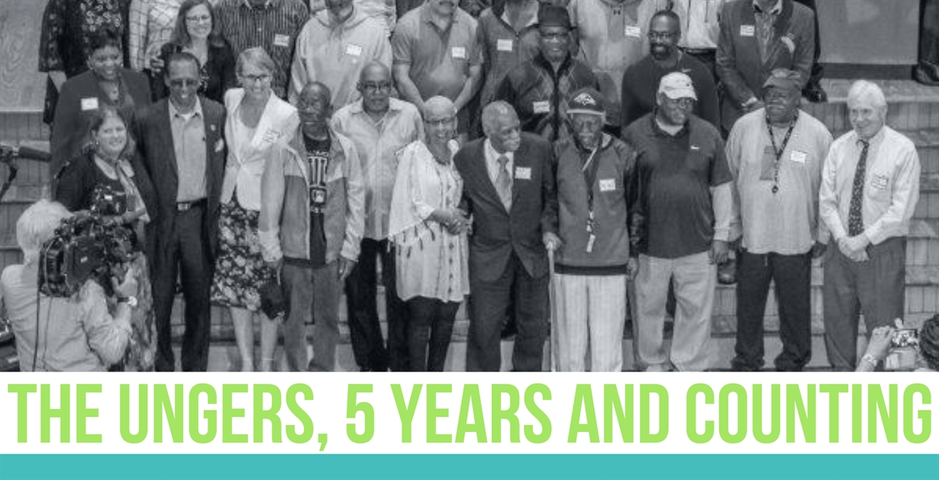
Studies have documented a very low
recidivism rate for convicted murderers.
Notes:
The Unger case is a “natural experiment” demonstrating the safety in releasing people convicted of violent crimes who have been incarcerated for decades. In 2012, a Maryland court overturned the convictions of about 185 people convicted of rape and murder due to unconstitutional jury instructions. These people were immediately released from prison after decades of incarceration. They received enhanced reentry services from a nonprofit organization. This report, published in November 2018, documents that since their release in 2012, only one person has been returned to prison. Everyone else was reintegrated into the community. The report also details the enormous cost savings involved in releasing elderly prisoners.

Slide 31
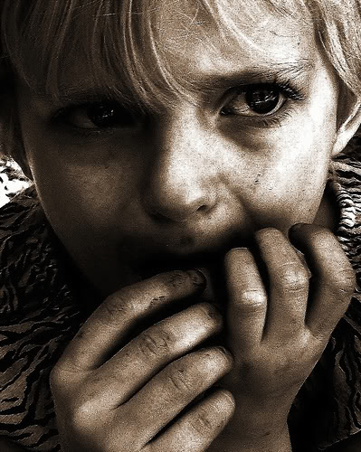
How do we want to treat
the children
(now residing in
adult bodies)
whom
our society
has failed?
Notes:
In the end, LWOP is a moral question. If we accept that in the vast majority of cases, people commit violent crimes because of the long term effects of childhood abuse and trauma, what is society’s responsibility to these children (now living in adult bodies) whom we failed to protect from abuse?

Slide 32
Why Should We End
LWOP in Vermont?
Notes:
So, why should we end LWOP in Vermont?

Slide 33
Restorative justice is the law of the land in Vermont.
LWOP sentences do not conform to the law.
Notes:
First of all, restorative justice is the law of the land in Vermont. LWOP sentences are the antithesis of restoration, and therefore violate the law.

Slide 34
Why Should Vermont Be The First State
To Affirmatively End LWOP for Adults?
* In 2015, LWOP for juveniles was removed from its Criminal Code.
* Vermont already has progressive criminal justice policies, such as the right
to vote for people with felony convictions as well as those inside prison,
the lack of felony murder laws, and strong compassionate release policies.
* There are only 15 people serving LWOP in Vermont.
Notes:
Discuss these points.

Slide 35
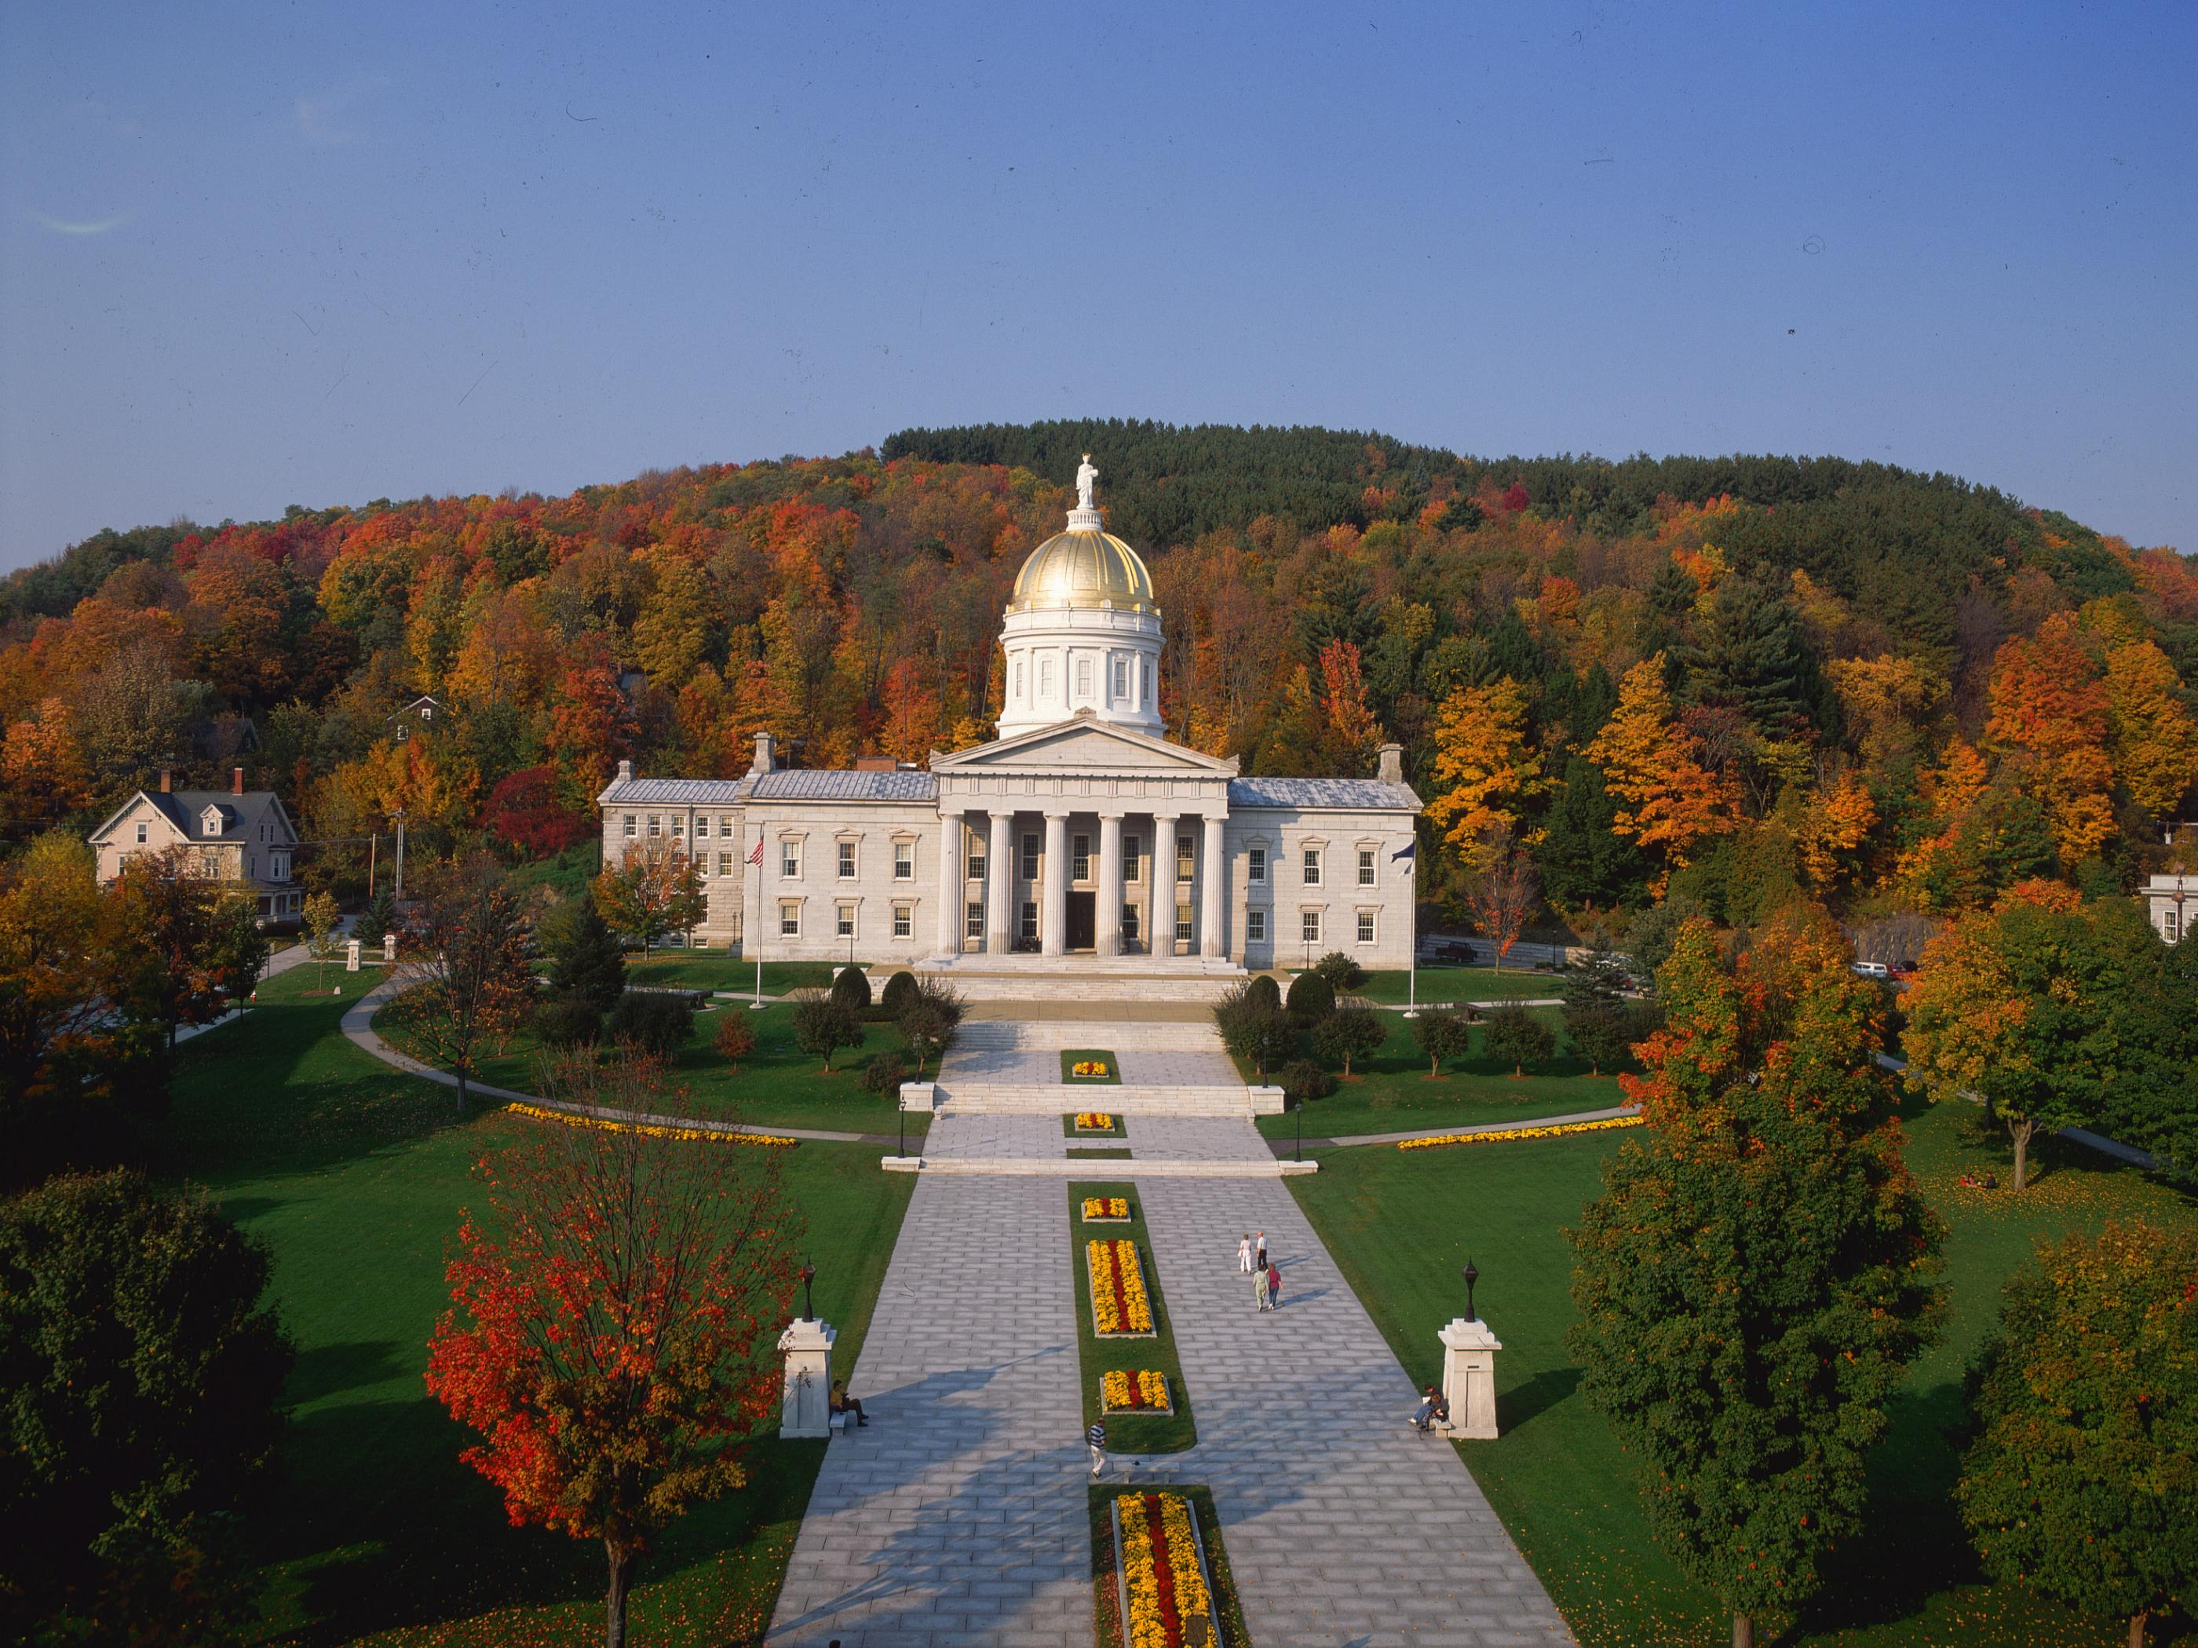
Vermont Legislation
To End LWOP
H.382 introduced in 2019
by Rep. Brian Cina and
co-sponsored by Rep.
Barbara Rachelson
Companion bill to be
introduced in January
2020 by Senator Dick Sears
Notes:
Discuss these points.

Slide 36
Call to Action!
Notes:
We need your help!

Slide 37
How You Can Help:
Sign the Change.org petition: https://www.change.org/p/vermont-state-legislature-abolish-life-without-parole
Send us your contact info (including town of residence) and let us know how you are connected to the issue (e.g, family member of person in prison). Tell us what you’d like to do to help (for example, write op-eds/letters to the editor, participate in media interviews, call/write to/speak with your elected officials, provide public testimony, or other ideas).
Sign on to our letter as an individual or organization (coming soon).
Notes:
Discuss what we want our attendees to do.

Slide 38
Contact Us!
Tom Dalton, VCJR Executive Director
Tom@vcjr.org
Skyler Nash, VCJR Intern and Community/Human Rights Activist
Nash.Skyler@outlook.com
Susan Lawrence, M.D., Esq.
Founder/CEO, The Center for LWOP Studies
Susan.Lawrence@lwopstudies.org
www.lwopstudies.org
Facebook page: @lwopstudies.org
Notes:
I will place our contact info on this slide.

Slide 39
Thank you for your attendance today
and for your support! We look forward
to partnering with you to create
transformational change in the Vermont
criminal justice system.
© 2019 Susan E. Lawrence
Notes:
Time for questions.

